Slide 1

CHAIN THE GAIN
Liberation language learning certificates with Blockchain

Slide 2
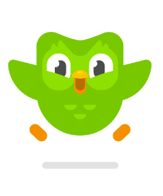


Slide 3
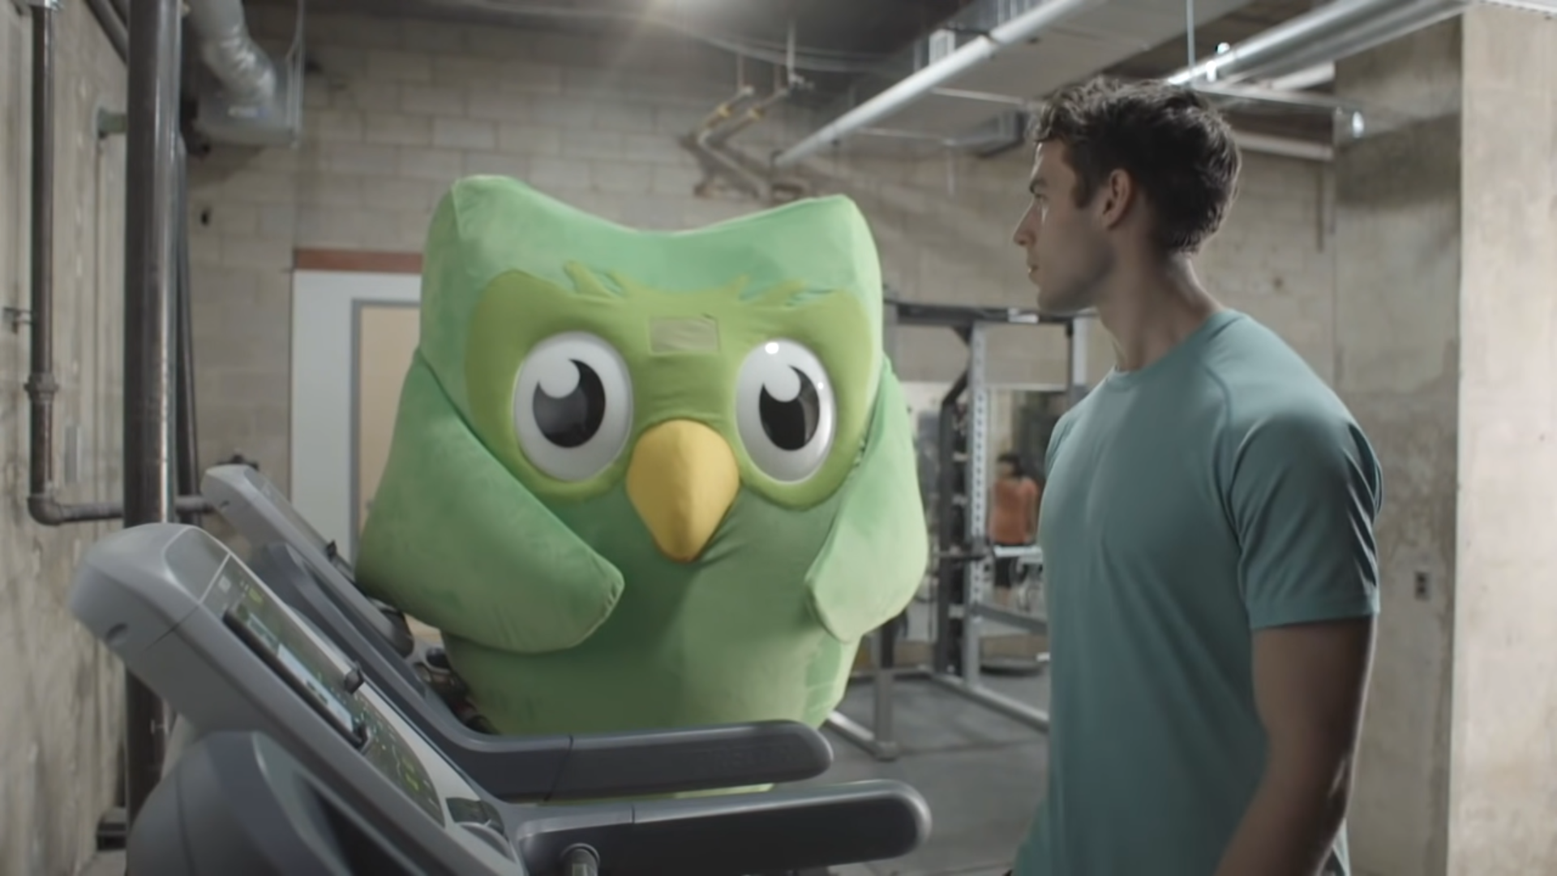

Slide 4
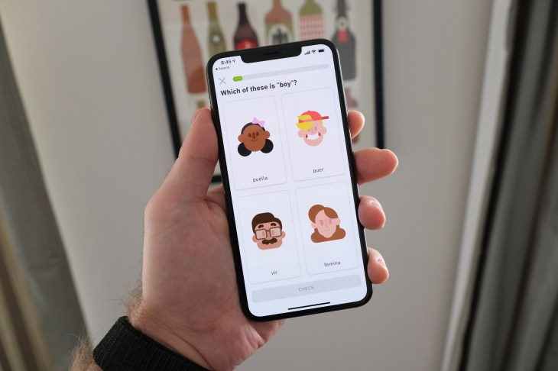

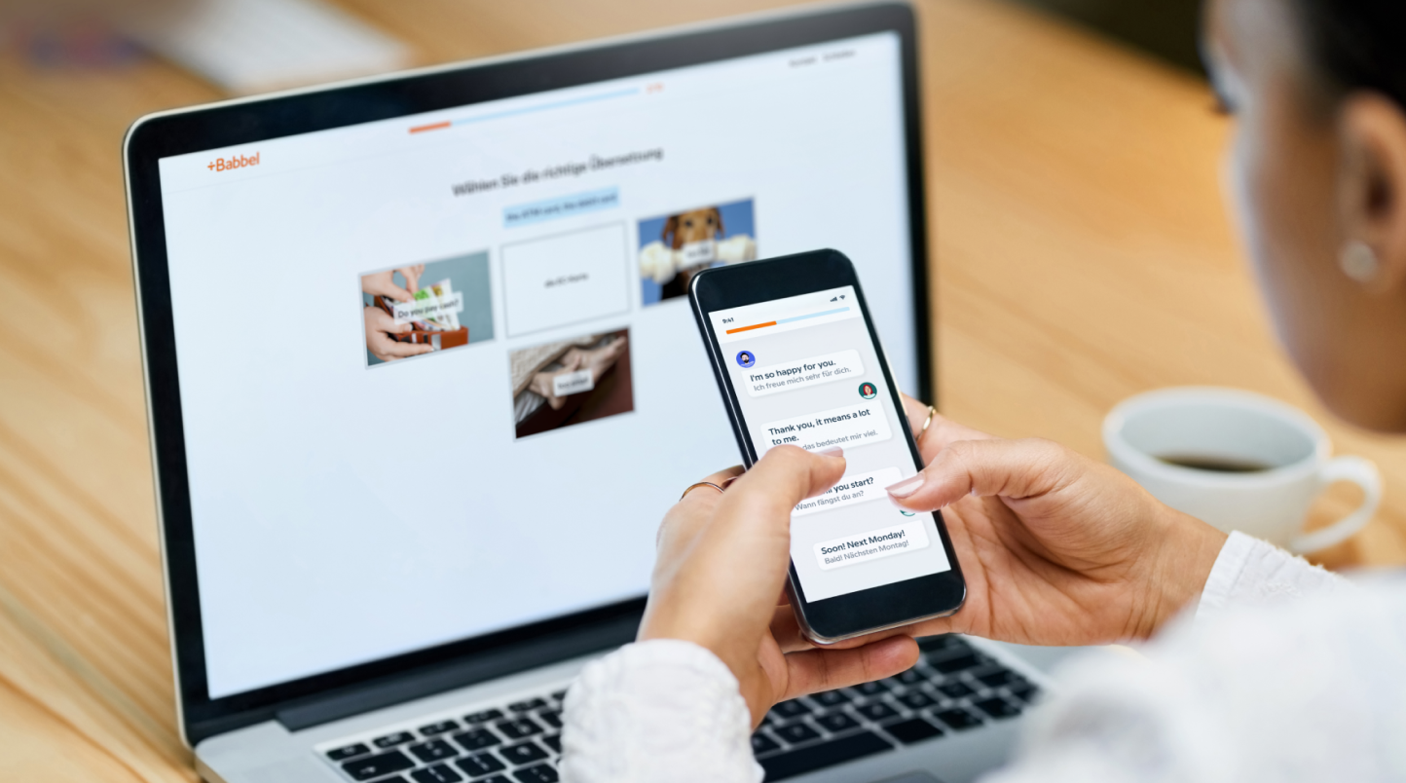

Slide 5
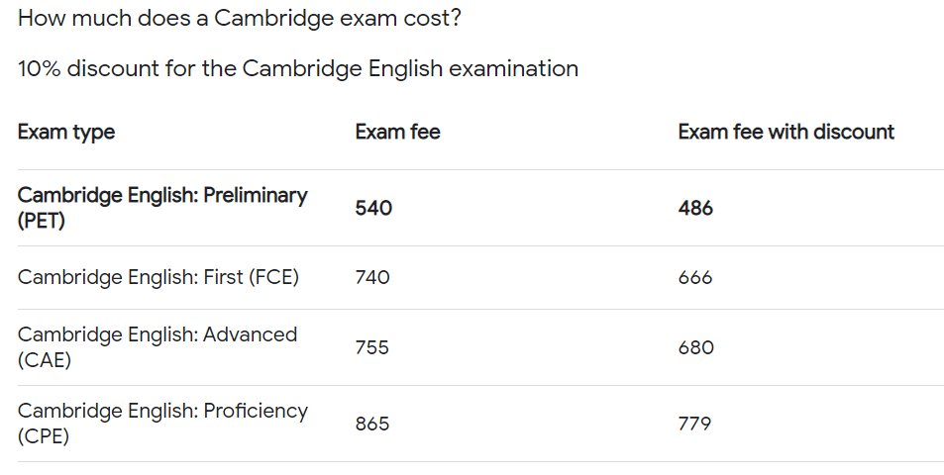
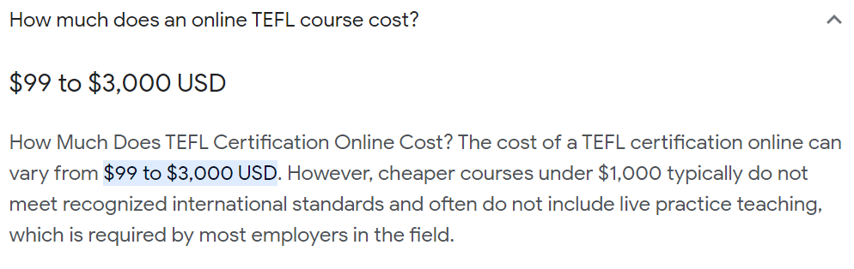
Why are we depending on institutions for certificates?

Slide 6
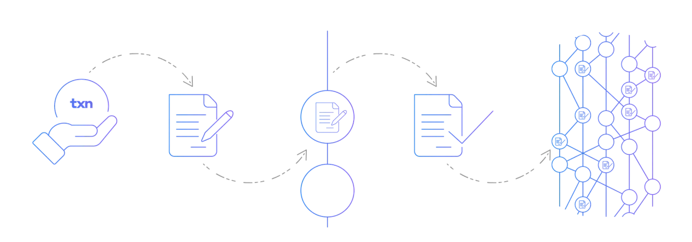
Can Blockchain liberate language certificates?

Slide 7
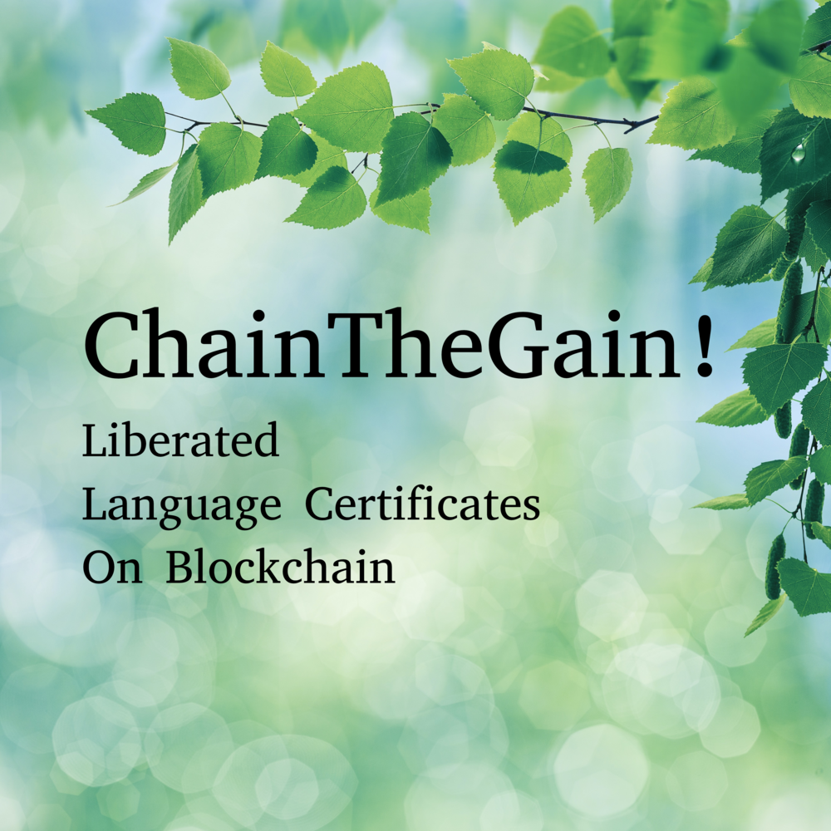
Language Microcertificate NFTs

Slide 8
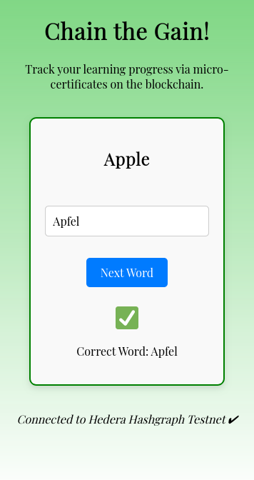
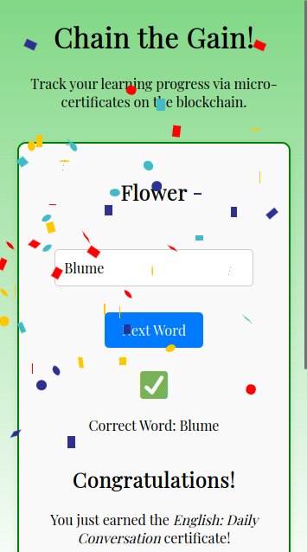
How does it work?
You study with our app at any time.
The app tracks your progress.
When you reach a milestone, you get a microcertificate.

Slide 9
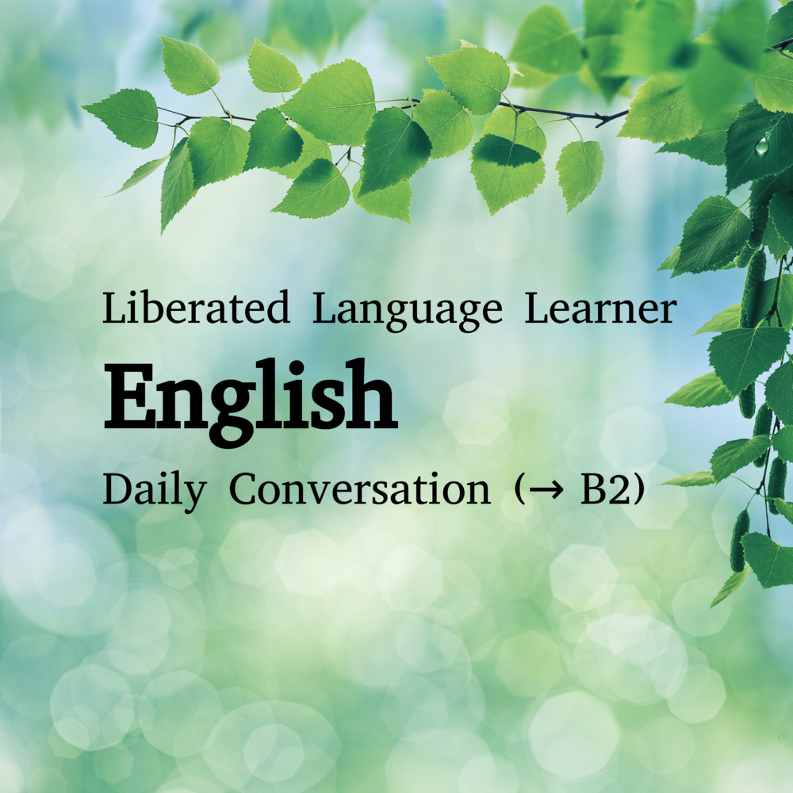
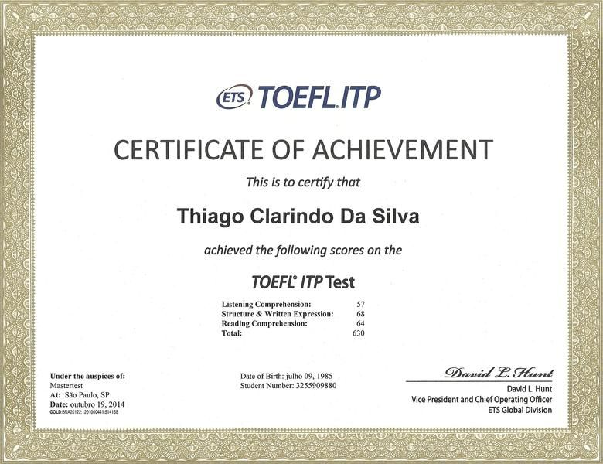
Gain micro certificates!
E.g. …
✓ Daily Conversations
✓ Grammar & Syntax
✓ Vocabulary Building
✓ Writing and Reading
✓ …

Slide 10
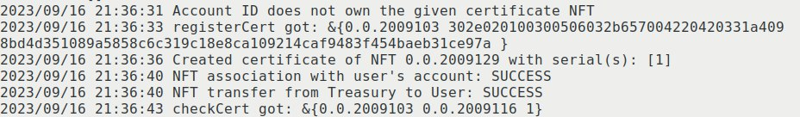
Best of all:
Your certificate is minted as an NFT assigned to your account!
✓ Dezentralized – ✓ Irrevocable – ✓ Verifiable

Slide 11
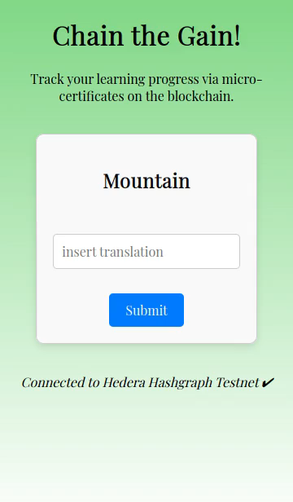

Slide 12
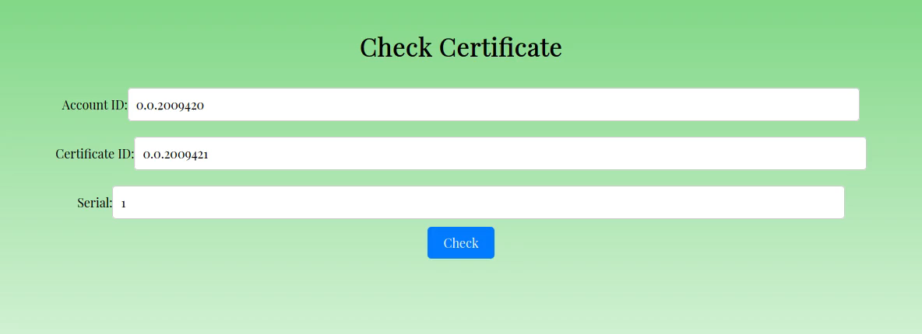

Slide 13
Let’s liberate language learning certificates with blockchain!

